Slide 1



Leia, the open source Cesium-based 3D viewer
FOSS4G BE+NL 2024
Kamiel Verhelst
The Province of Zeeland and Geodan are joining forces to develop an open-source digital twin!
LEIA
Notes:
Introduction:
How did we get together?
Why OS?
Why a generic viewer?
Viewer
Design
Goals/priorities
Functionality (demo!)
Lookout
Functional
Community
Conclusion

Slide 2

Kamiel Verhelst Technical Data Consultant Geodan / Sogelink

Slide 3
Goal
To develop an open source, accessible, easy-to-use 3D GIS viewer

Slide 4
scarcity of OS initiatives for complete viewers
starting with 3D is hard!
user-friendliness is often lacking
WHY?
‘digital commons’
gain experience in public-private partnerships in OS
no need to spend more public money on closed software

Slide 5
It’s more fun together!
HAVE
Use cases
Existing Digital Twins
Geo-expertise
Experimental 3D viewer
WANT
Support with development of viewer functionality
To develop tools for modelling, scenario-building and prediction
Open source!
Digital Twinning in real use cases
Open source!

Slide 6
It’s more fun together!
HAVE
Use cases
Existing Digital Twins
“We are not a software provider, but a government.”
Geo-expertise
Experimental 3D viewer
WANT
Support with development of viewer functionality
Digital Twinning in real use cases

Slide 7
LEIA
Design Principles
Easy to use
Easy to deploy
Easy to configure
Easy to extend
Browser-based
Design for non-expert users
Released as Docker image
Fully configurable via JSON file
Configurations can be switched easily
[work in progress]

Slide 8
LEIA
Architecture
Config server
3D Toolbox
Configurations in JSON format
Various tools for generating 3D Tilesets and terrains
Express.js, Docker
GDAL, Docker
Viewer
Viewer
3D viewer interface
Config
Configurations in JSON format
3D data
Express.js
Cesium, Svelte, Docker

Slide 9
LEIA
Features
Support for WMS, WFS, GeoJSON, 3D Tiles and more
Support for Cesium Terrain Tiles
Measuring in 3D
Location search
Spatial bookmarks
Stories
Translatable UI
Connect to metadata libraries (GeoNetwork, CKAN)
🚧Special layer type for flood simulation 🚧

Slide 10
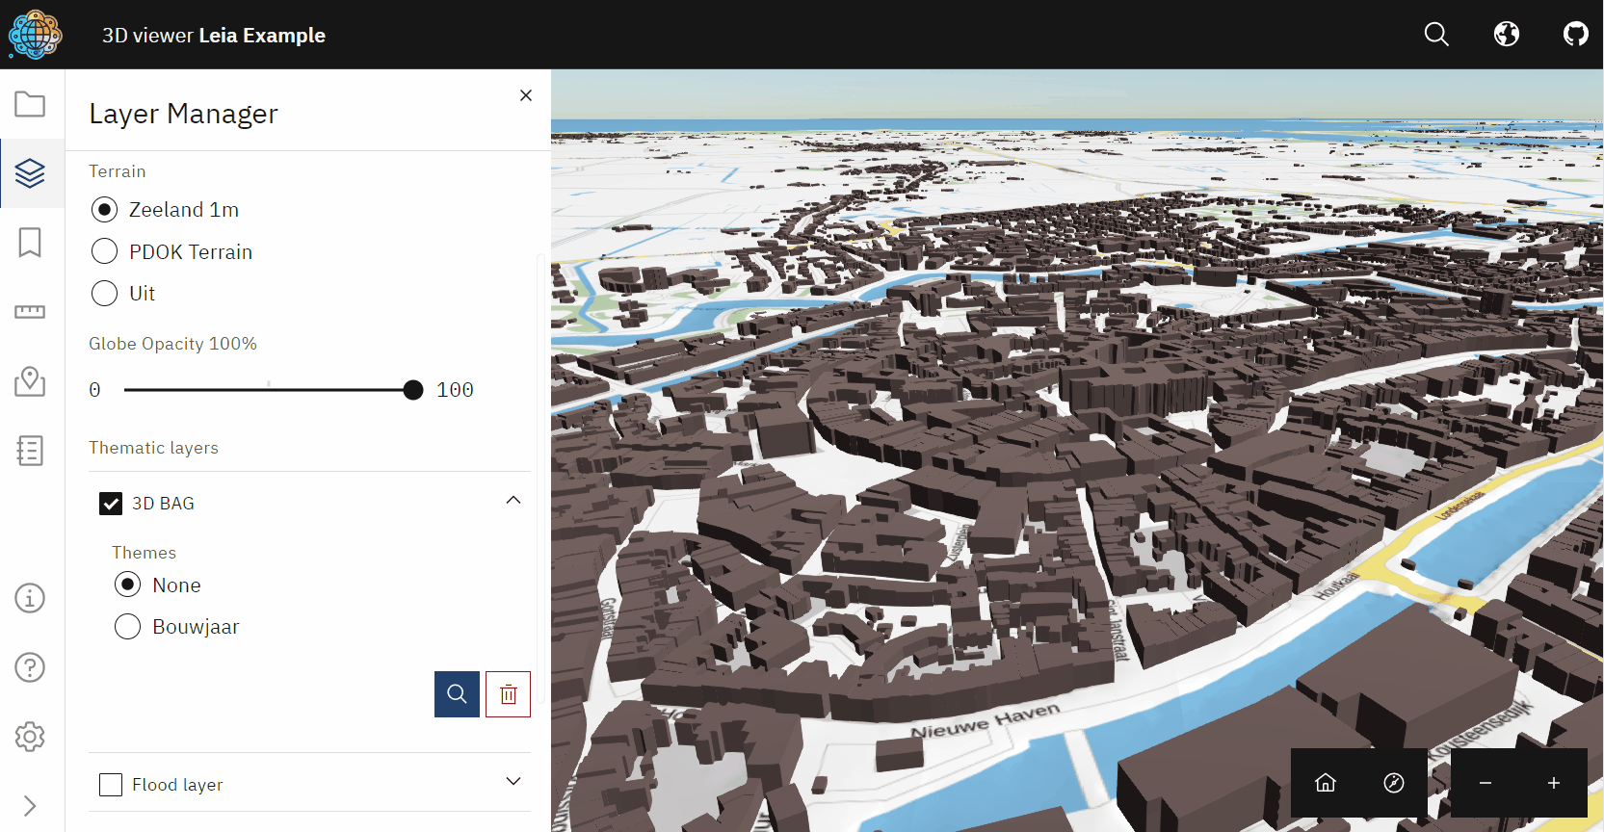
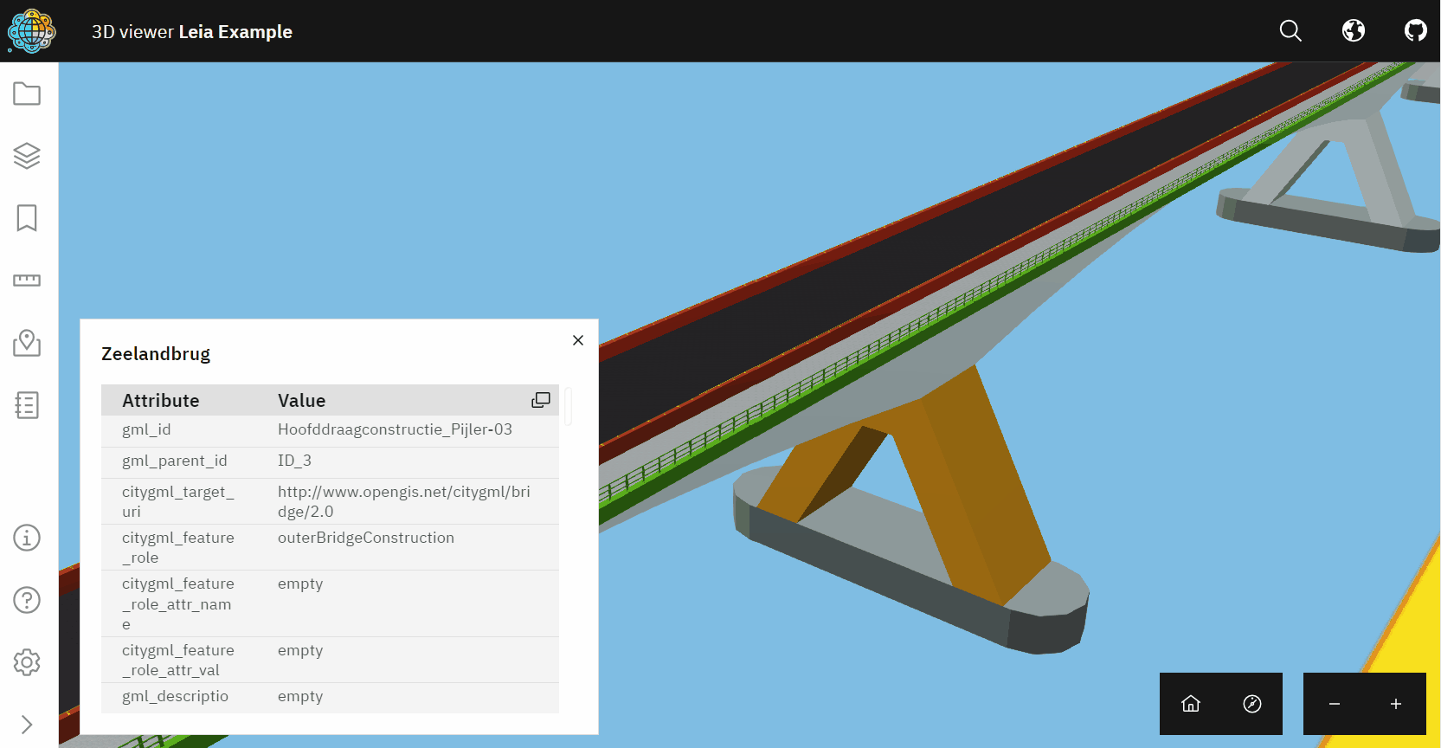
LEIA
3D Tiles
Styled 3D Tilesets
BIM models as 3D Tiles, with attributes

Slide 11
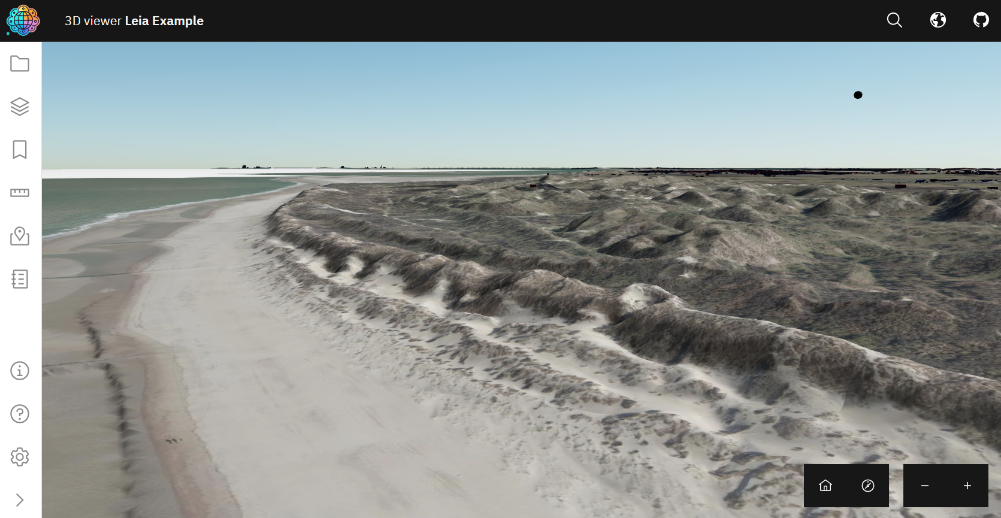
LEIA
Terrains

Slide 12
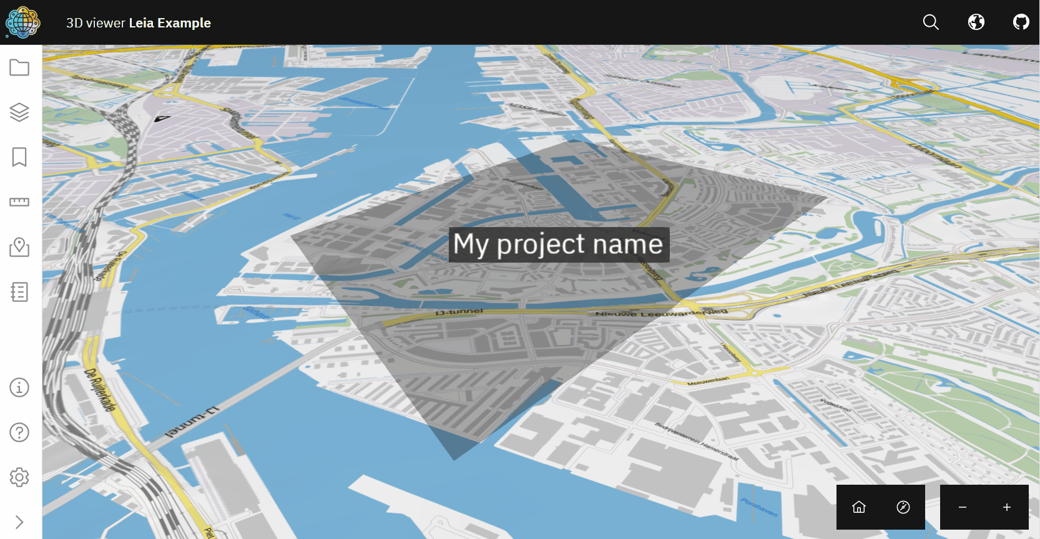
LEIA
Project views

Slide 13
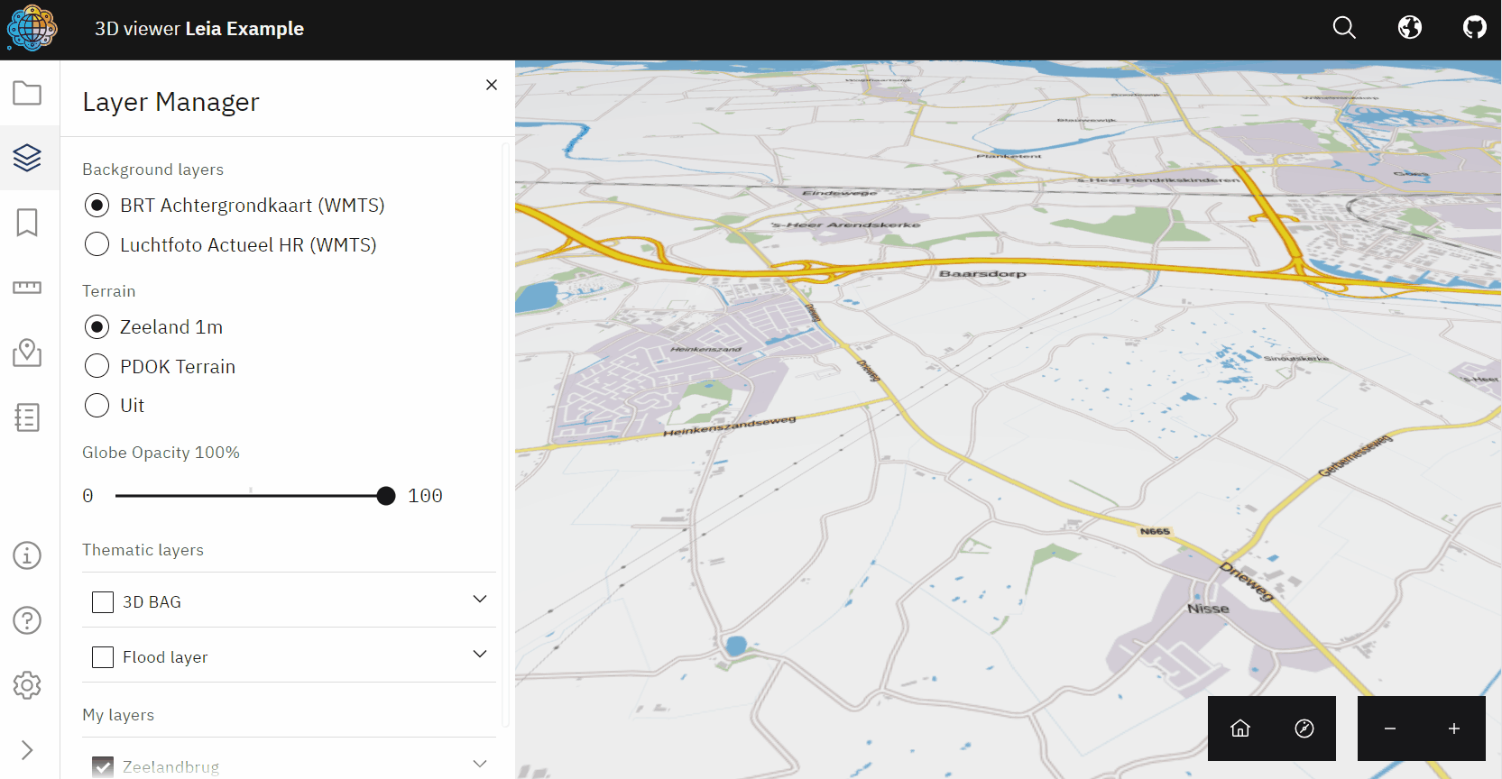
LEIA
Metadata libraries
Connects to GeoNetwork and CKAN APIs

Slide 14
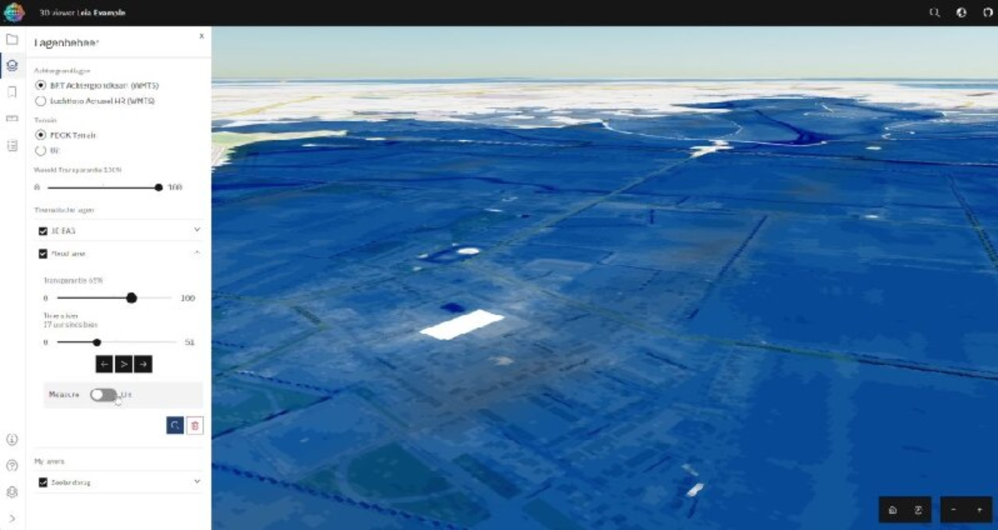
LEIA
🚧 Flood visualizations 🚧
Support for WMS, WFS, GeoJSON, 3D Tiles and mor

Slide 15
LEIA
Design Principles + outlook
Easy to use
Easy to deploy
Easy to configure
Easy to extend
Browser-based
Design for non-expert users
Released as Docker image
Fully configurable via JSON file
Configurations can be switched easily
[work in progress]
Extend documentation
Collect user feedback
Easier to configure (independent of host)
Edit and save configurations from UI
Share configuration
Modular plugins

Slide 16

LEIA
Get involved!
We welcome…
Contributors
Users
Visionairies
Join our soon-to-be community!

